Slide 1

NATIONAL UNIVERSITY OF MODERN LANGUAGES
Faculty of Engineering and Computing
Department of Software Engineering

Slide 2

SOFTWARE DESIGN AND ARCHITECTURE
LECTURE NO. 10
Introduction to Software Engineering Design
Course Instructor: | Mr. Ahsan Arif
 | Lecturer Department of Software Engineering NUML Islamabad
Date: April 29, 2024
Software Engineering Design: Theory and Practice

Slide 3
LECTURE CONTENTS
  Deployment Diagrams
    Introduction
    Elements of Deployment Diagram
    Construct Deployment Diagram for Case Study
Date: April 29, 2024
Software Engineering Design: Theory and Practice

Slide 4
UML – DEPLOYMENT DIAGRAM (PHYSICAL VIEW)
Introduction:
A deployment diagram is a UML diagram type that show the execution of architecture of a system;
  including nodes such as hardware or software execution environment, and the middleware connecting them.
Deployment diagrams are typically used to visualize the physical hardware and software of a system. Using it you can understand how the system will be physically deployed on the hardware.
Deployment diagrams help model the hardware topology of a system compared to other UML diagram types which mostly outline the logical components of a system.
Date: April 29, 2024
Software Engineering Design: Theory and Practice
Notes:
Class diagrams model the static behavior of objects, i.e.
Attributes of objects
Operation of objects
Relationships between objects.

Slide 5
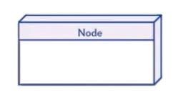
Elements of Deployment Diagram
Deployment diagram shows the physical implementation of a system or a physical architecture of hardware. It presents a static view of the system.
Elements of Deployment Diagram:
There are only three elements of a deployment diagram. They are nodes, artifacts and connections.
Node: Represent hardware or software elements of a system. Nested nodes are allowed in deployment diagram. They are shown as three-dimensional boxes.
Date: April 29, 2024
Software Engineering Design: Theory and Practice
Notes:
Class diagrams model the static behavior of objects, i.e.
Attributes of objects
Operation of objects
Relationships between objects.

Slide 6
Elements of Deployment Diagram (cont.)
  There are two types of nodes: device nodes and execution nodes.
  Device nodes:
    are actual computing resources with processing memory and services for running software in them. For example, mobile phones and PC’s.
      They can be represented using stereotype like <<server>>, <<storage>>, <<cd-rom>>, <<PC>> etc.
  Execution nodes:
    are software computing resources which themselves are present within the node. They may provide services for the host or are capable of executing other software resources.
Node instance can also be shown in the diagram.
A Node can contain components.
You can tag nodes and artifacts with tagged values, they are used to provide more information about a node.
Date: April 29, 2024
Software Engineering Design: Theory and Practice
Notes:
Class diagrams model the static behavior of objects, i.e.
Attributes of objects
Operation of objects
Relationships between objects.

Slide 7
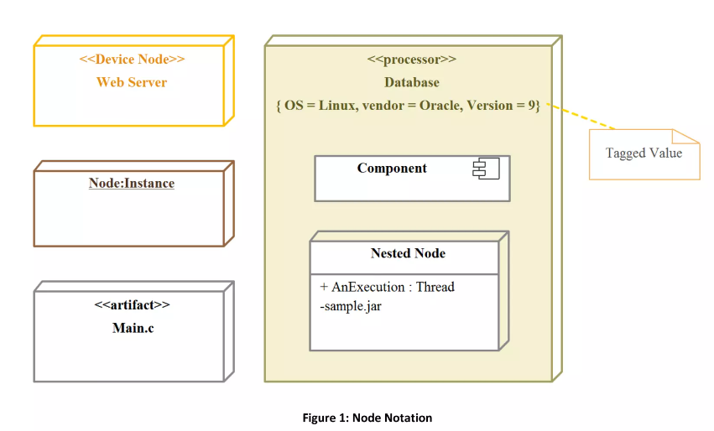
Date: April 24, 2024
Software Engineering Design: Theory and Practice
Notes:
Deferrable Triggers in UML state diagrams refer to triggers that are candidates to be retained by the state machine if they do not lead to any transitions out of the state. These triggers can be deferred, meaning they are not consumed immediately, but can be used later to initiate a transition. This mechanism allows for the postponement of certain trigger events until the appropriate conditions are met within the state machine.

Slide 8
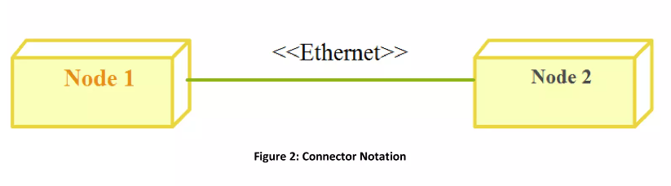
Elements of Deployment Diagram (cont.)
Artifacts: are products of a software development process. They can range from models, files to documents. Artifacts are denoted by a rectangular box with <<artifact>> stereotype and a file icon in the box.
Connectors: are similar to associations and dependencies that are used in UML. Connectors are lines drawn between nodes, they are used as a communication medium between nodes. Name of the physical connection can be represented using stereotypes. For Example <<Ethernet>>, <<message bus>> etc.
Date: April 24, 2024
Software Engineering Design: Theory and Practice
Notes:
Class diagrams model the static behavior of objects, i.e.
Attributes of objects
Operation of objects
Relationships between objects.

Slide 9
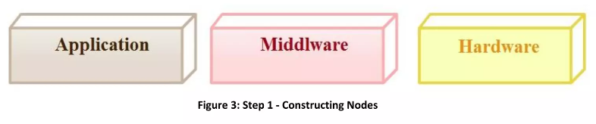
Constructing Deployment Diagram for Our Case Study
We have three layers in our system – Application layer, Middleware layer and Hardware. First model these nodes.
Application Layer:
  Our Application layer has three components: User Interface (UI), State Machine and Process Order.
  UI acts as a compartment for LCD display and the switches for selecting the flavor of the coffee.
  Model the dependencies between the components inside Application code.
Date: April 24, 2024
Software Engineering Design: Theory and Practice
Notes:
Class diagrams model the static behavior of objects, i.e.
Attributes of objects
Operation of objects
Relationships between objects.

Slide 10
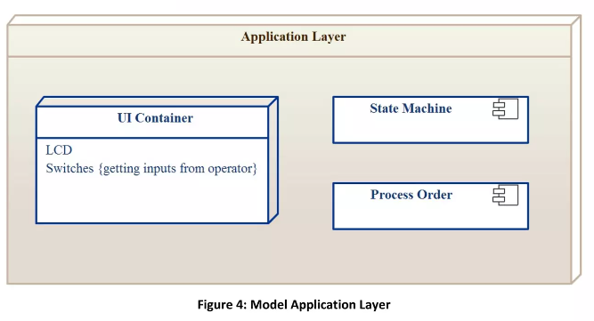
Constructing Deployment Diagram for Our Case Study
Date: April 24, 2024
Software Engineering Design: Theory and Practice
Notes:
Class diagrams model the static behavior of objects, i.e.
Attributes of objects
Operation of objects
Relationships between objects.

Slide 11
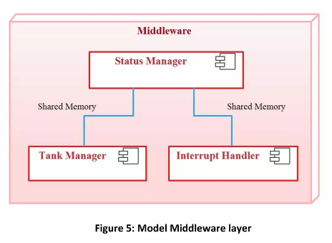
Constructing Deployment Diagram for Our Case Study
A middleware has three components: Status Manager, Tank Manager and Interrupt Handler.
  Status Manager requires input from Tank Manager and Interface Handler, so add dependencies from Status Manager.
Date: April 24, 2024
Software Engineering Design: Theory and Practice
Notes:
Class diagrams model the static behavior of objects, i.e.
Attributes of objects
Operation of objects
Relationships between objects.

Slide 12
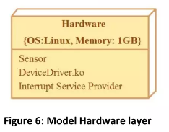
Constructing Deployment Diagram for Our Case Study
Hardware: There are many modules and sub-modules required for a system. Here’s mentioned a couple of them.
Once individual node construction is done, make connections between nodes and name the connection type.
Add tagged value at necessary places which helps to clarify a node further.
Look for the need to use artifact, stereotypes if any.
Note: Our case study does not use execution nodes, artifacts. So, you would not find them in our Deployment Diagram. The figure below shows the completed Deployment Diagram for our Case Study.
Date: April 24, 2024
Software Engineering Design: Theory and Practice
Notes:
Class diagrams model the static behavior of objects, i.e.
Attributes of objects
Operation of objects
Relationships between objects.

Slide 13
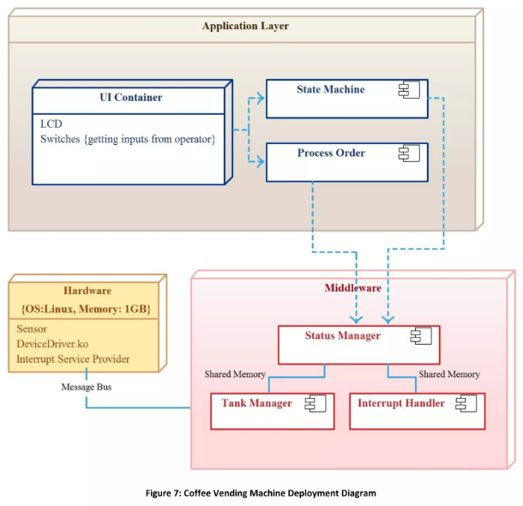
Date: April 24, 2024
Software Engineering Design: Theory and Practice
Notes:
Class diagrams model the static behavior of objects, i.e.
Attributes of objects
Operation of objects
Relationships between objects.

Slide 14
Summary
Deployment Model is used to model physical architecture of a system.
Elements of Deployment Diagram are – nodes, artifacts and connectors.
There are two types of nodes – Device and Execution node.
Date: April 24, 2024
Software Engineering Design: Theory and Practice

Slide 15
Thank You...
Mr. Ahsan Arif
Lecturer (Dept. of Software Engineering)
ahsanarif.se42@gmail.com

